Slide 1

Gold prices prediction

Slide 2

SYSTEMATIC SQUAD
Nikita Rahi - 28
Asma Shaikh – 05
Pallavi Sawant – 32
Vedant Bhalekar – 52
Pradnya More – 34
Shubham Upadhyay – 30
Amruta Bandopadhyay - 22

Slide 3
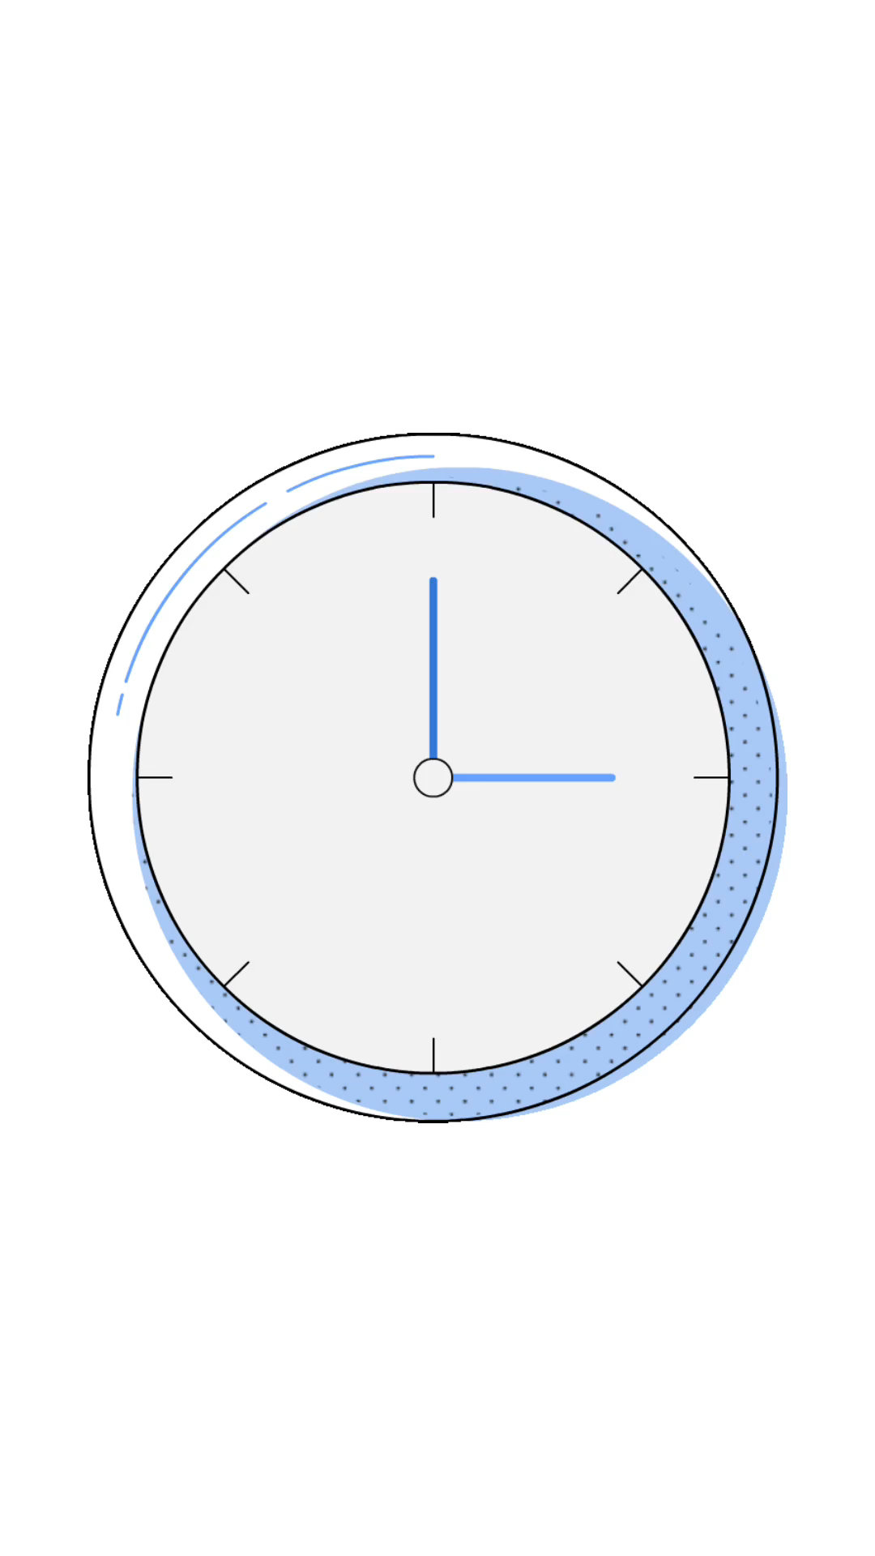
Introduction
Time series arise as recordings of processes which vary over time.
A recording can either be a continuous trace or a set of discrete observations.
We will concentrate on the case where observations are made at discrete equally spaced times.
By appropriate choice of origin and scale we can take the observation times to be 1, 2, . . . T and we can denote the observations by Y1, Y2, . . . , YT .

Slide 4


Software used
Required packages for
“Time Series Analysis”
numpy
pandas
matplotlib
statsmodel.tsa.seasonal

Slide 5

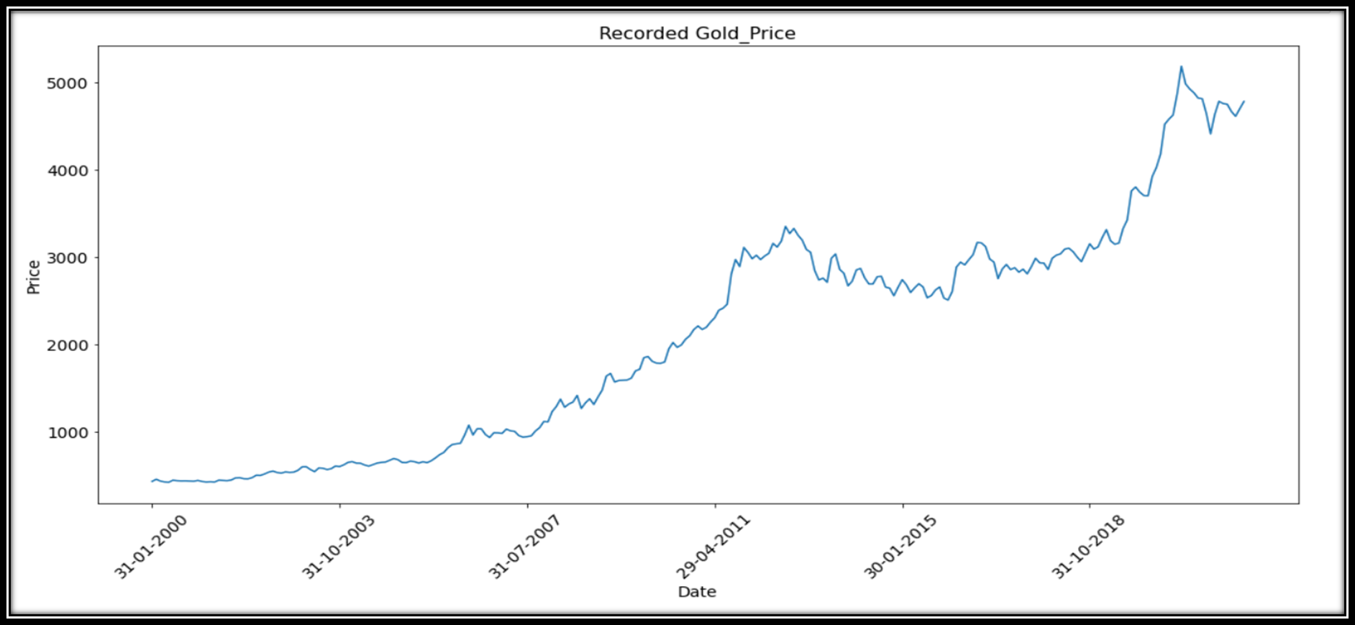
Data visualization:
DATA INTRODUCTION
Monthly gold data mentioned
as the last date of the month.
Price data Rupees per gram.
There are total 263 observations.
From year 2000 to 2021.

Slide 6
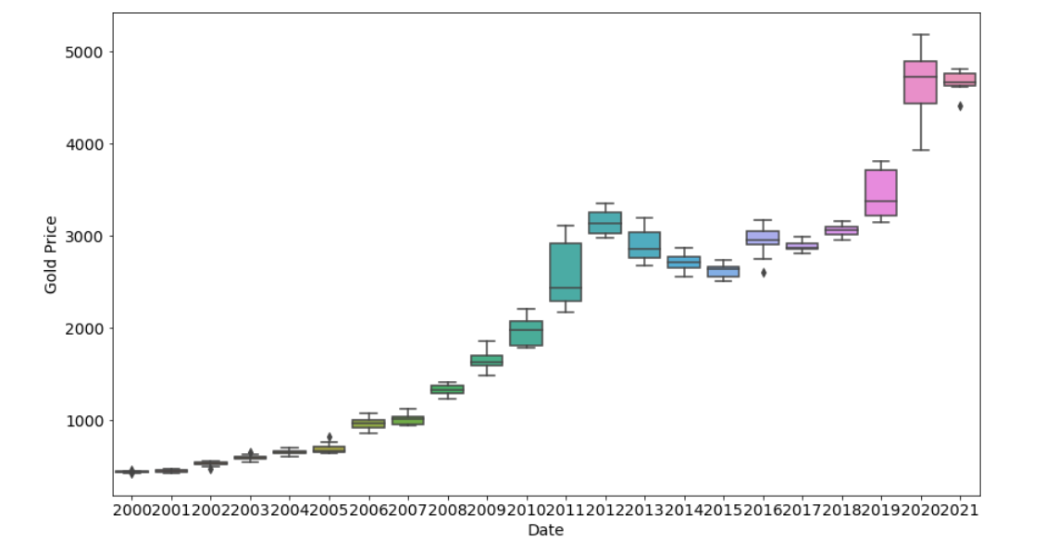
Yearly “Box-Plot” for Gold Price dataset

Slide 7

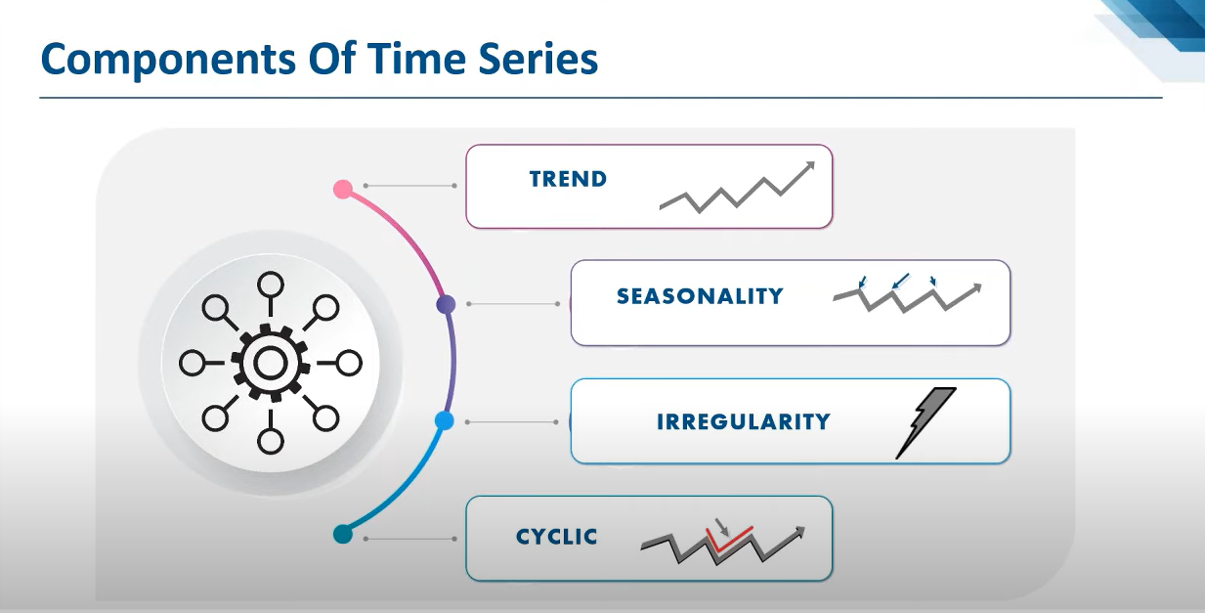
Components of Time Series

Slide 8
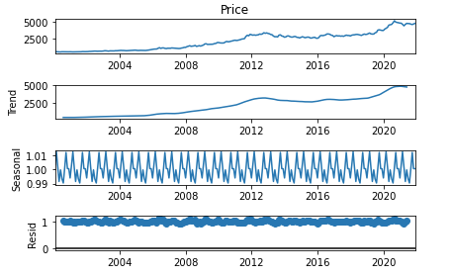
Multiplicative decomposition

Slide 9
Testing for stationarity and trend stationarity
Augmented Dickey-Fuller test:
_______The null hypothesis for the test is that the data is not stationary.
_______The alternate hypothesis for the test is that the data is stationary.
ADF Statistic: 0.6057144242539166
p-value: 0.9877556362370769
Kwiatkowski-Phillips-Schmidt-Shin:
_______The null hypothesis for the test is that the data is stationary.
_______The alternate hypothesis for the test is that the data is not stationary.
KPSS Statistic: 2.3045598973941983
p-value: 0.01

Slide 10
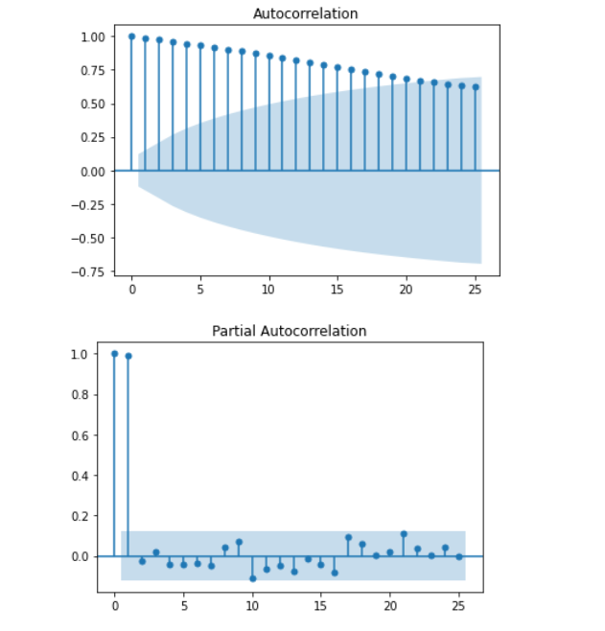
Autocorrelation and Partial-Autocorrelation
Data is non-stationary.

Slide 11
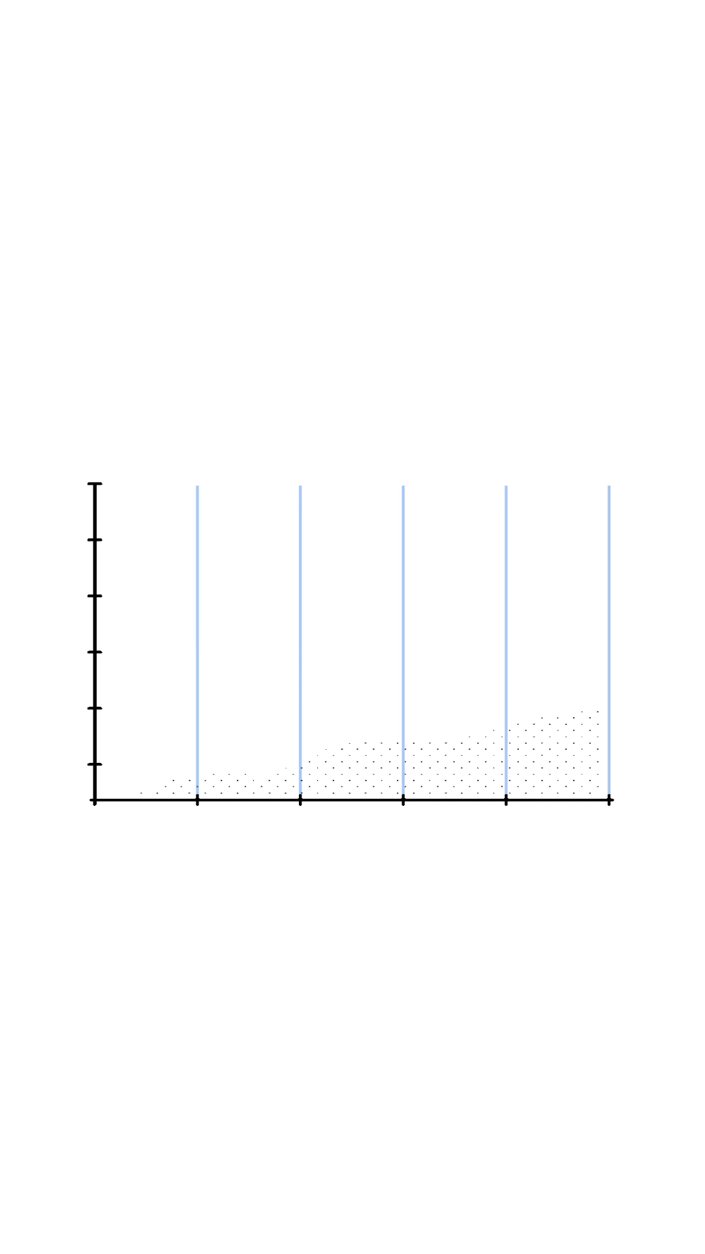
TRAIN AND TEST
TRAIN DATA: Used to estimate
any Parameters of forecasting methods.
We have selected First 210 observations for train data set.
(i.e. 80%)
TEST DATA: Used to evaluate its accuracy.
53 observations left for test data set.
(i.e. 20%)

Slide 12
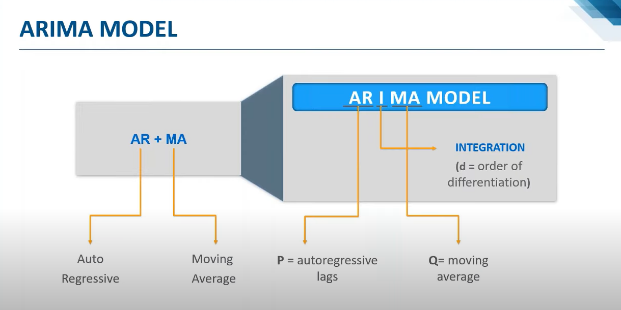
ARIMA model

Slide 13
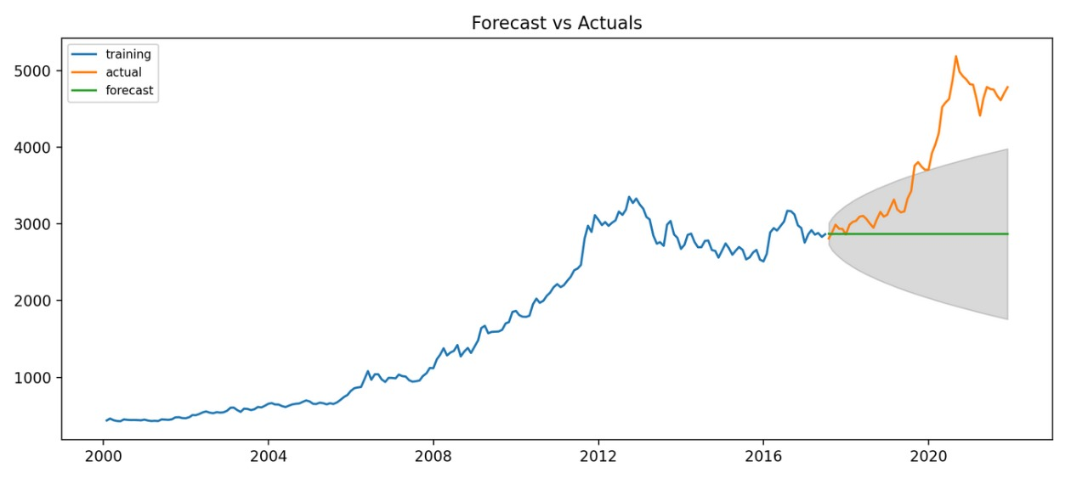
ARIMA best fit
Performing stepwise search to minimize aic
ARIMA(2,1,2)(0,0,0)[0] intercept : AIC=3075.195, Time=0.67 sec
ARIMA(0,1,0)(0,0,0)[0] intercept : AIC=3079.106, Time=0.03 sec
ARIMA(1,1,0)(0,0,0)[0] intercept : AIC=3073.405, Time=18.65 sec
ARIMA(0,1,1)(0,0,0)[0] intercept : AIC=3071.565, Time=0.16 sec
ARIMA(0,1,0)(0,0,0)[0] : AIC=3086.765, Time=0.02 sec
ARIMA(1,1,1)(0,0,0)[0] intercept : AIC=3071.200, Time=0.22 sec
ARIMA(2,1,1)(0,0,0)[0] intercept : AIC=3073.192, Time=0.53 sec
ARIMA(1,1,2)(0,0,0)[0] intercept : AIC=3073.190, Time=0.47 sec
ARIMA(0,1,2)(0,0,0)[0] intercept : AIC=3071.571, Time=0.21 sec
ARIMA(2,1,0)(0,0,0)[0] intercept : AIC=3072.522, Time=0.05 sec
ARIMA(1,1,1)(0,0,0)[0] : AIC=3076.900, Time=0.28 sec
Best model:
ARIMA(1,1,1)(0,0,0)[0] intercept

Slide 14
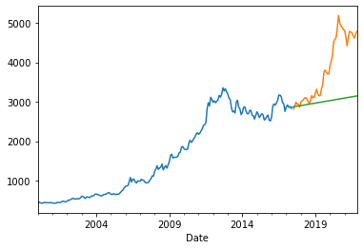

Exponential smoothing
2nd stage
1st stage

Slide 15

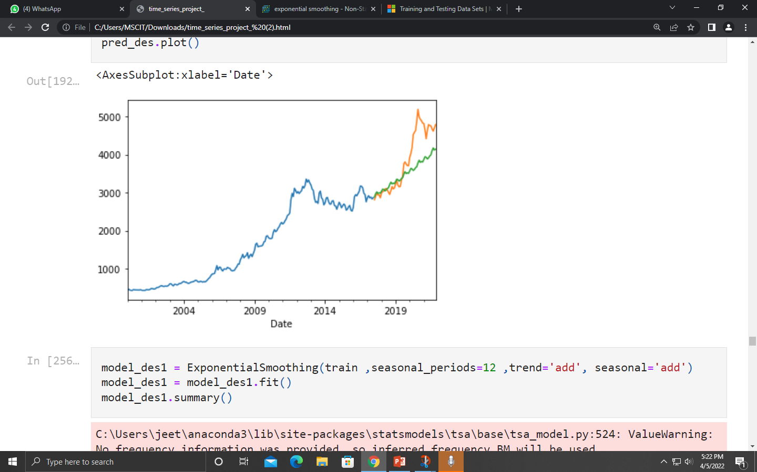
3rd stage exponential smoothing

Slide 16

Comparison of MAPE values

Slide 17
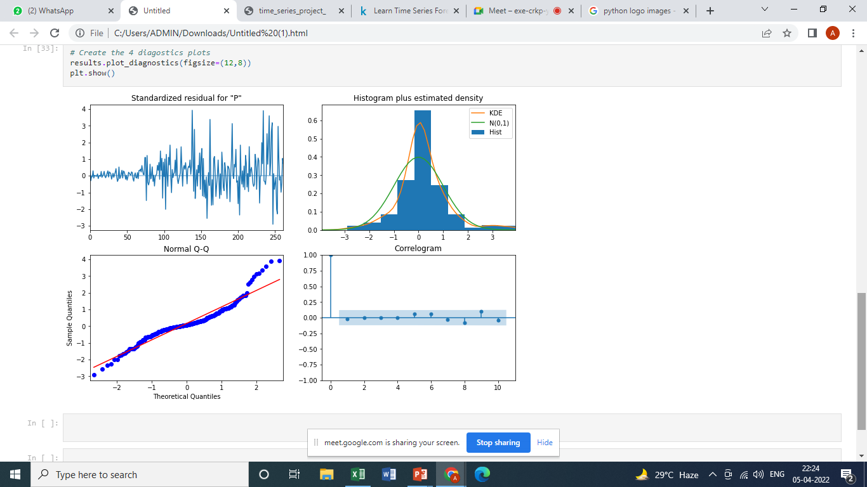
Model adequacy

Slide 18
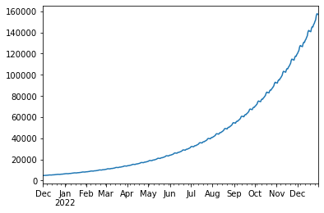
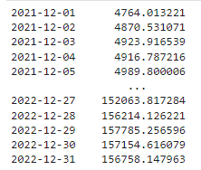
Prediction plot

Slide 19
Thank you

